Slide 1
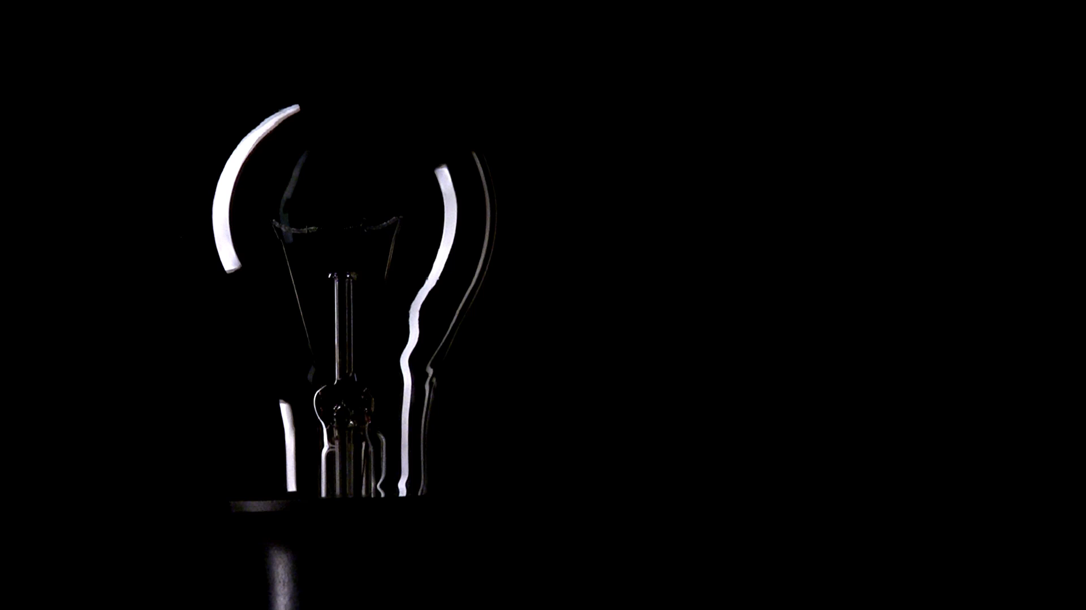
SMART LED LAMP

Slide 2
Problem Description
Smart devices are conquering the market. A smart LED light will be a high demanding product.
Following are the results of a survey done regarding this product.
Are you interested in buying this kind of a product?
How much are willing to pay for this product?
2 | 3 | 4 | 5
3.39 % | 15.25 % | 50.85 % | 30.51 %
Less than 500 /= | 500 – 1000 /= | Over 1000/=
11.86 % | 57.63 % | 30.51 %

Slide 3


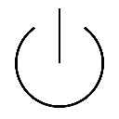
Block Diagram Of Circuit
230V(AC)
STEP down voltage
5V(DC)
Microcontroller
Atmega328p
Relay Switch
Bluetooth Module
HC05

Slide 4
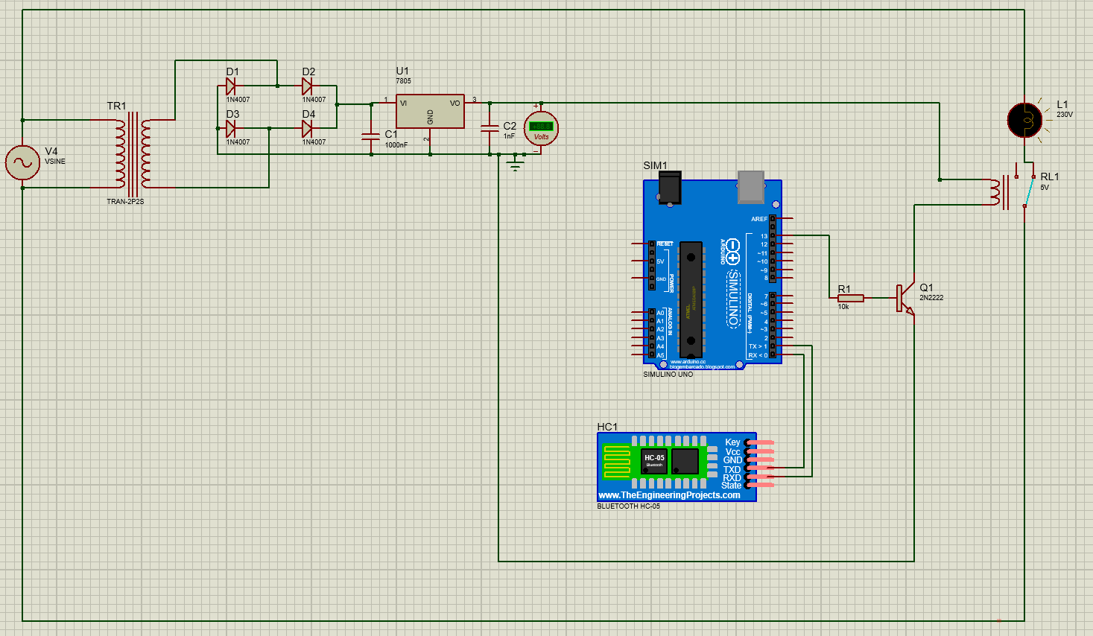
Proteus Simulation

Slide 5
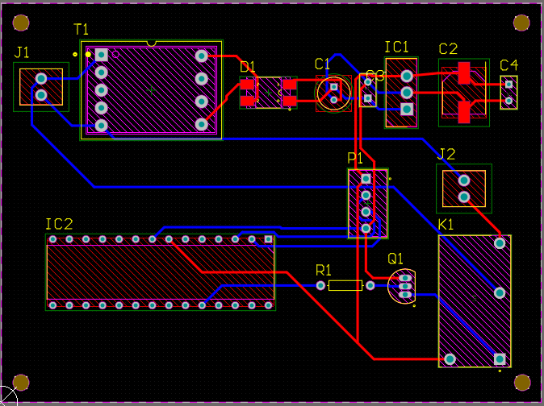
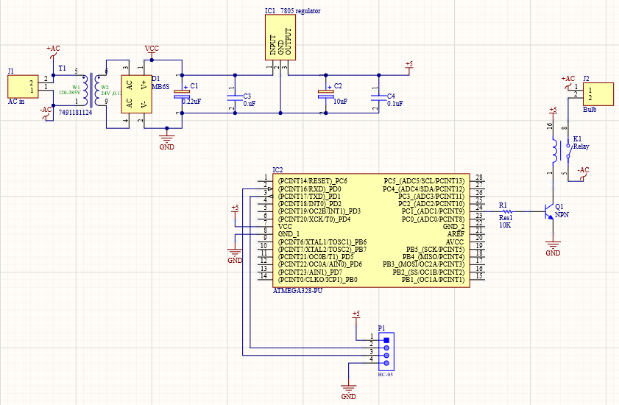
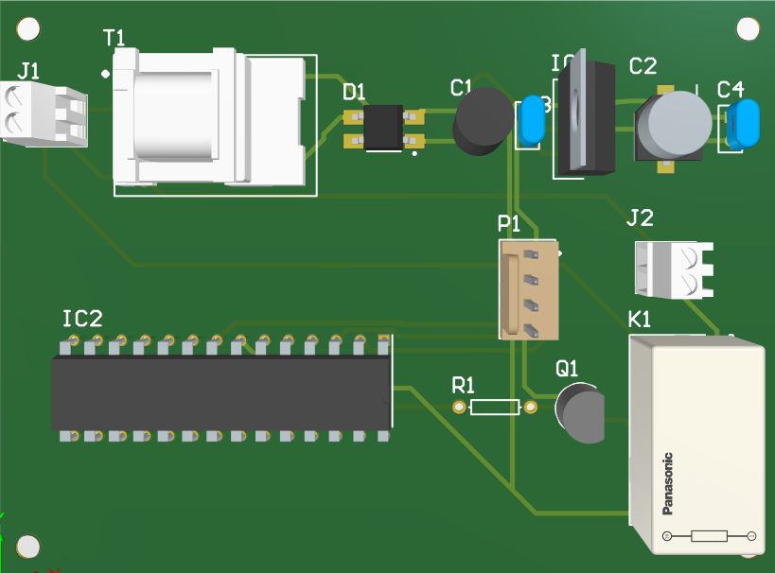
PCB Design Using Altium Designer

Slide 6
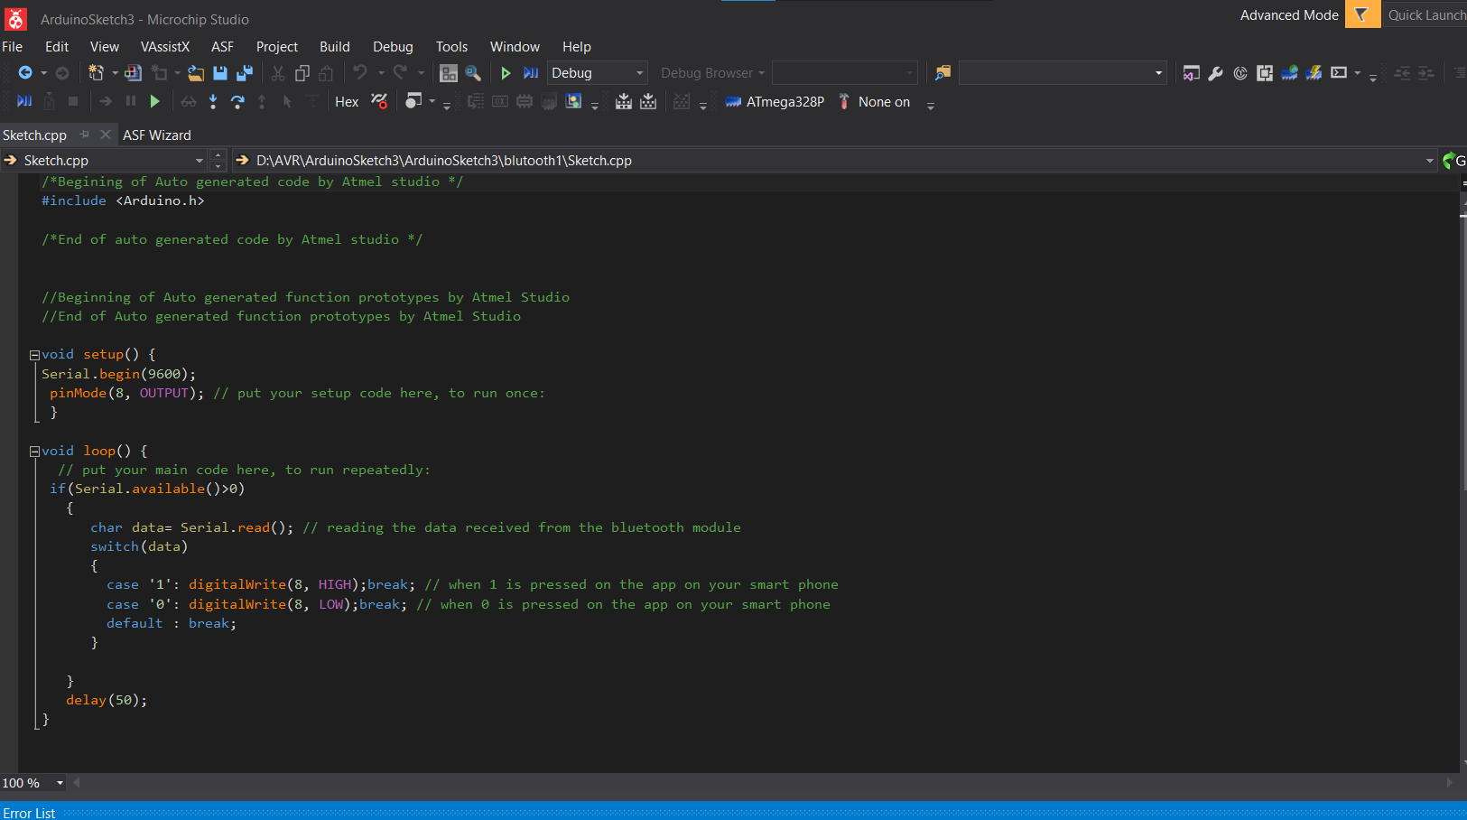
Programming AVR Microchip

Slide 7
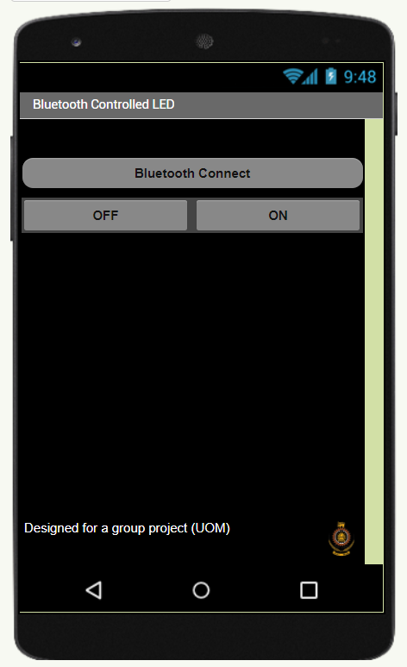
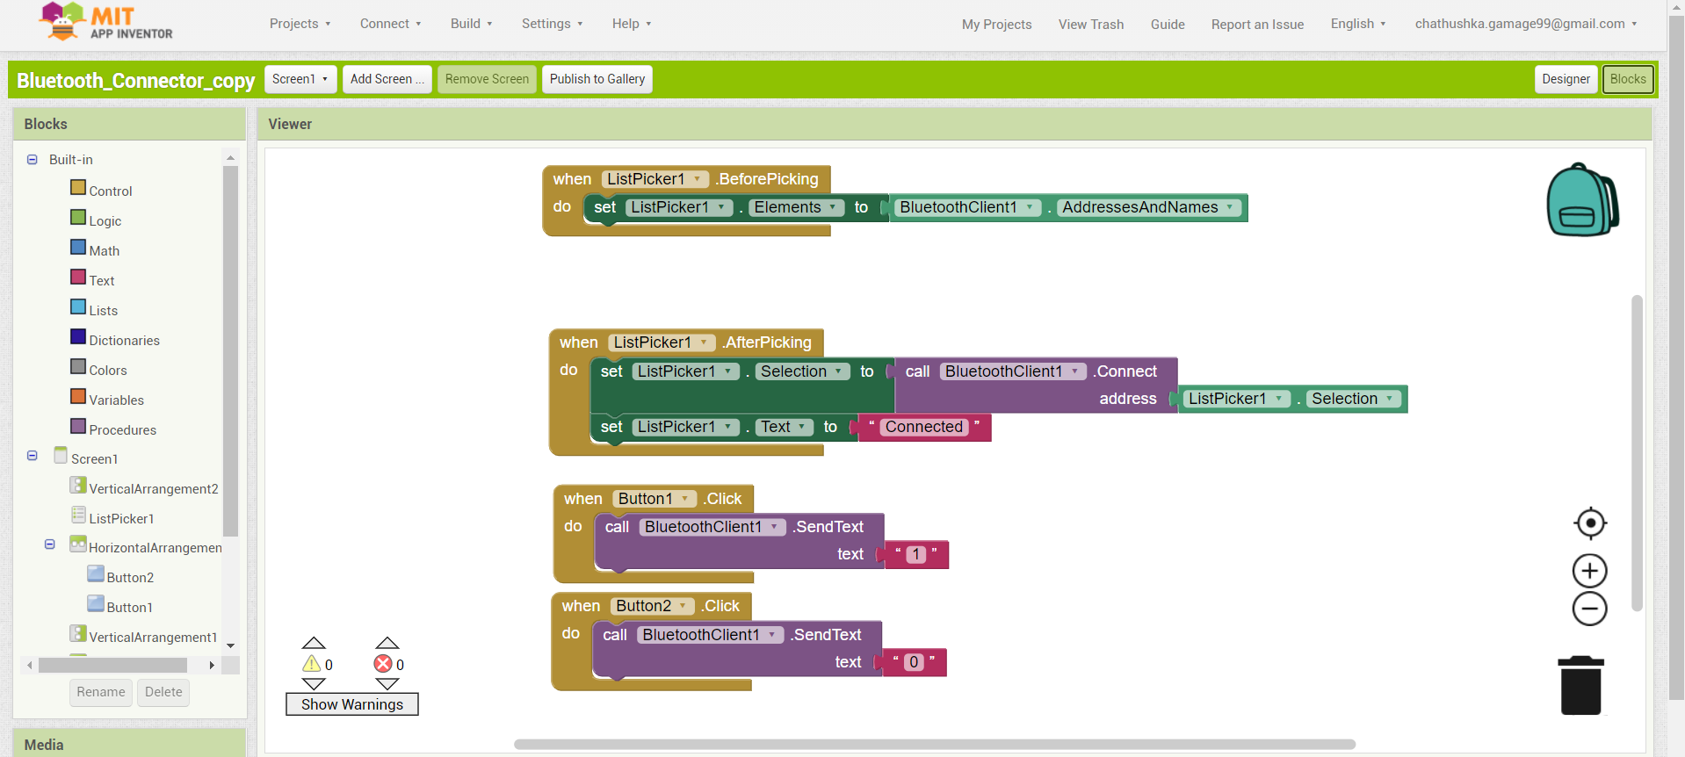
Mobile Application Development
An user-friendly interface is been developed for the user to communicate with the Smart Lamp.

Slide 8
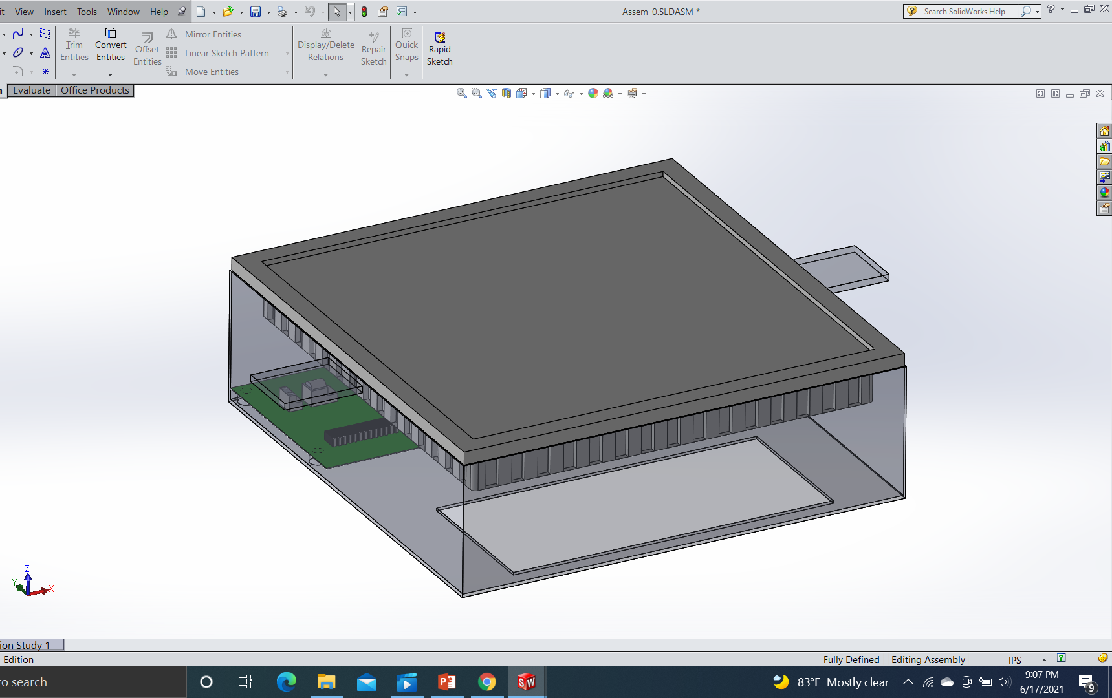
Sketches of the product enclosure
Final product

Slide 9
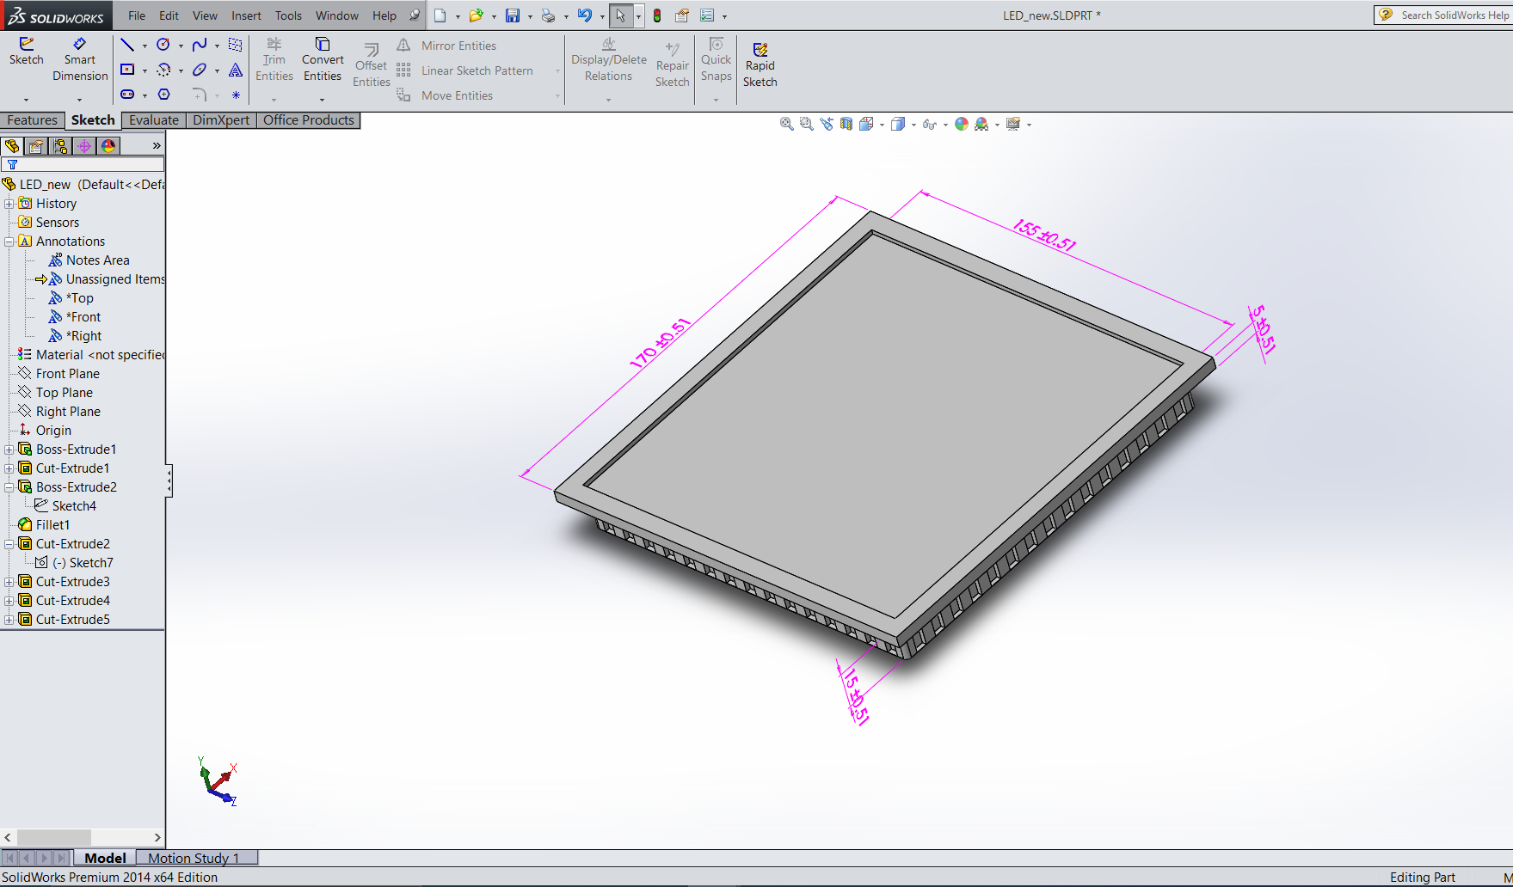
LED panel light

Slide 10
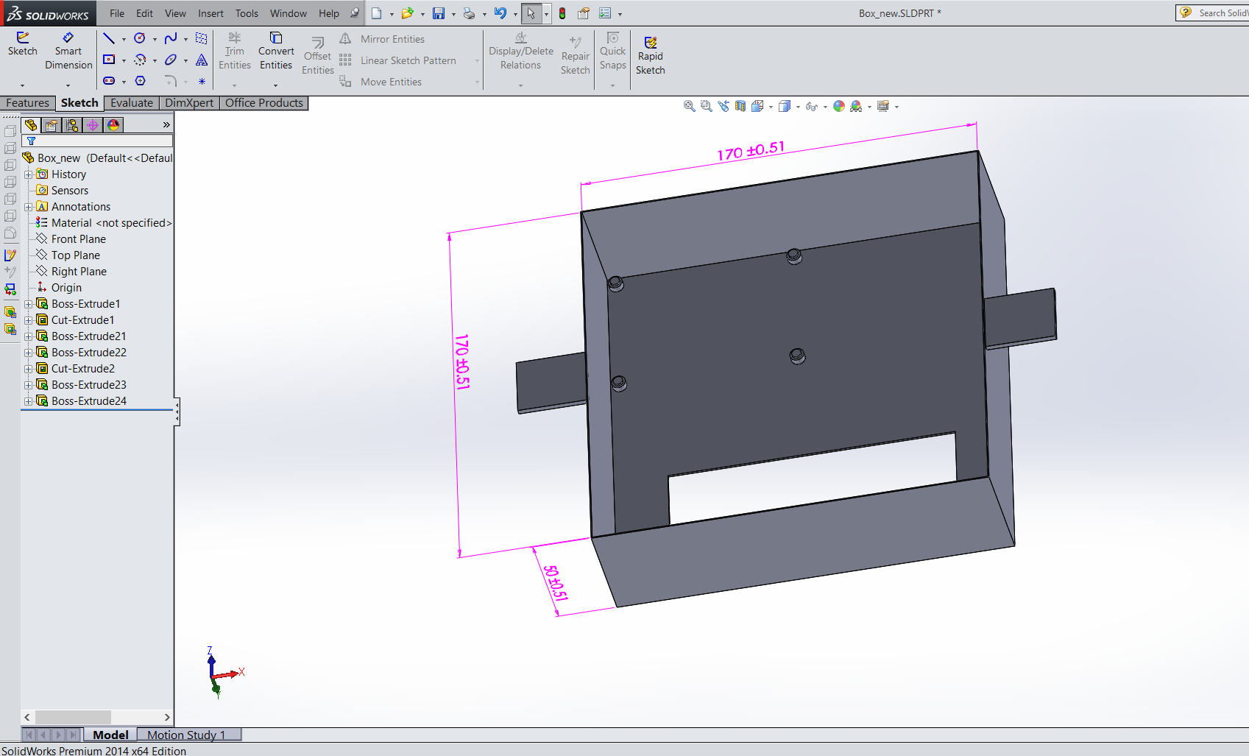
The box which contains the PCB and the bulb
Clips
Hole
hole

Slide 11
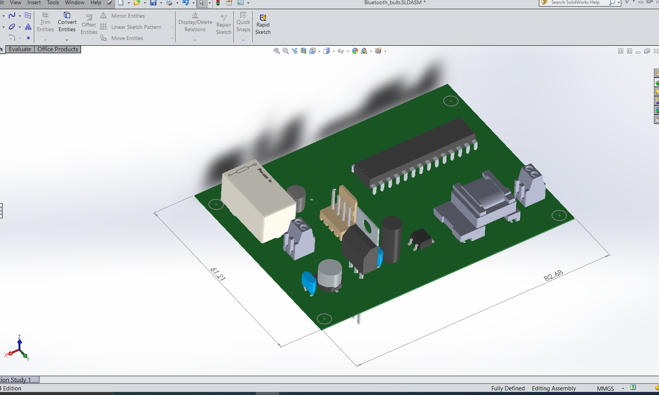
3D Model Of PCB

Slide 12
Estimated Budget
Diode rectifier bridge | 85.00
Relay switch | 150.00
header ports | 55.00 x 2
pin header | 80.00
transformer | 300.00
LED panel light | 250.00
Resistors | 5.00
Atmega328p microcontroller | 400.00
Hc05 Bluetooth Module | 400.00
Capacitors | 10.00 x 4
7805 regulator | 25.00
PCB manufacture | 100.00
Box | 75.00
packaging | 50.00
Total | 2015.00

Slide 13
Marketing and Sales and Beyond
Product packaging
Material - Cardboard , bubble wrap
Content
Product name
Product Logo
Price
Warranty period
Special features
Contact information

Slide 14
Marketing Methods
Through social media
Sharing flyers
Using brand advocates
Marketing Plan
Cost per unit | 2015.00
price | 3500.00
Amount of first stock | 1000
Net profit | 1485000.00

Slide 15
Repair and Maintenance
One year warranty
Reuse
A discount for an exchange of a used bulb to a new one.

Slide 16
Thank You!

